Slide 1
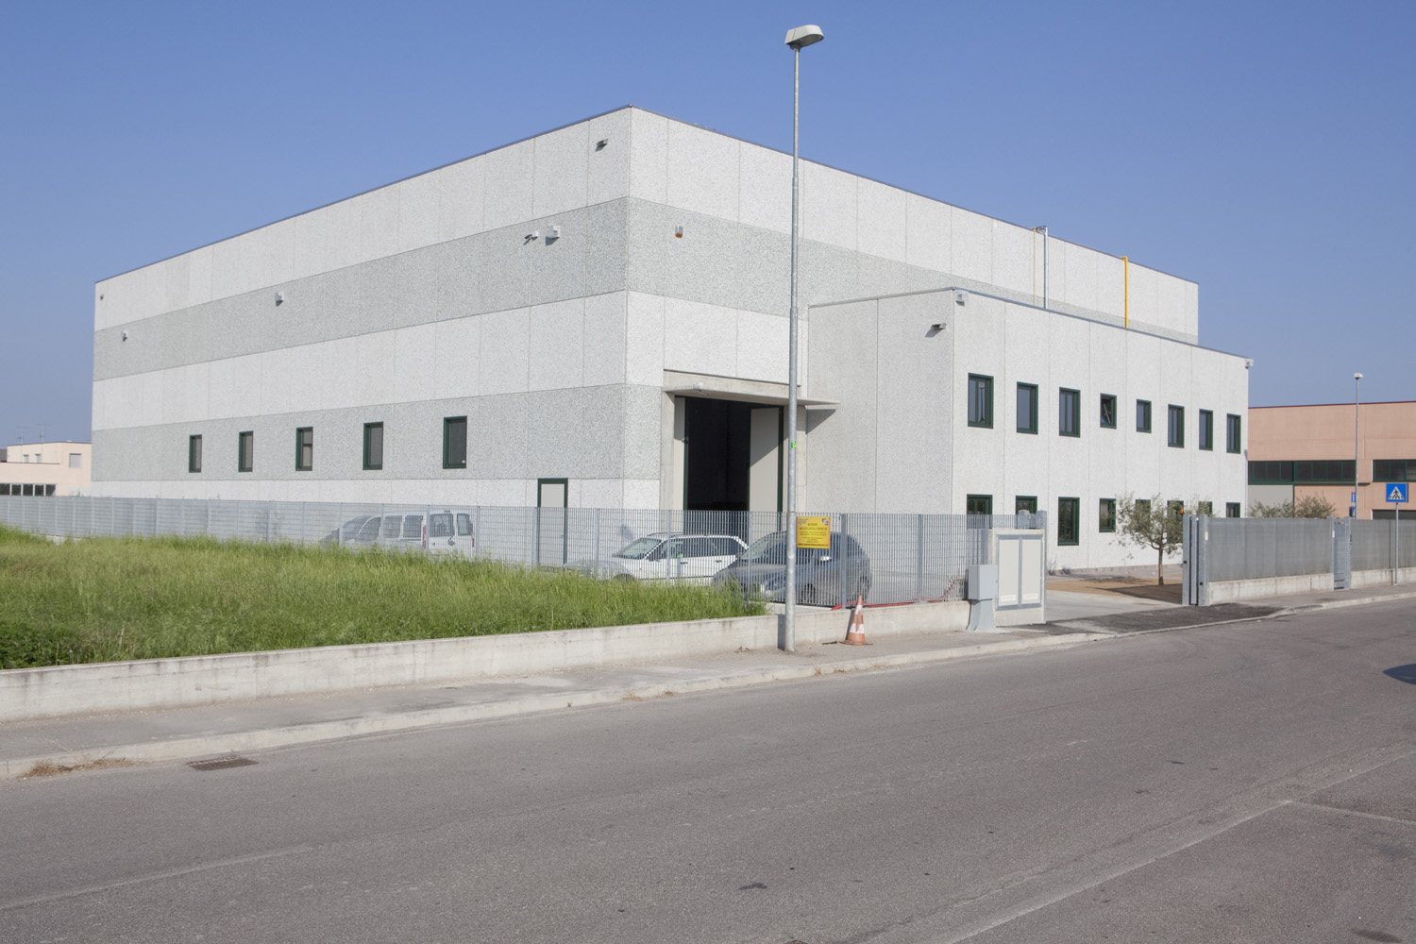
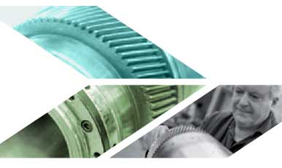
Production MDT Changzhou
Bonetti Marco srl. Brilliance from Italy to the rest of the world.
Customised
AUTOMATED GEOMETRIES
MARCO BONETTI s.r.l. : Sede Operativa: Via Paesa, 7 - 46048 Roverbella (Mn)
Tel. +39 0376 693666 – Fax +39 0376 692980
Website: www.marcobonettisrl.it Email: info@marcobonettisrl.it

Slide 2
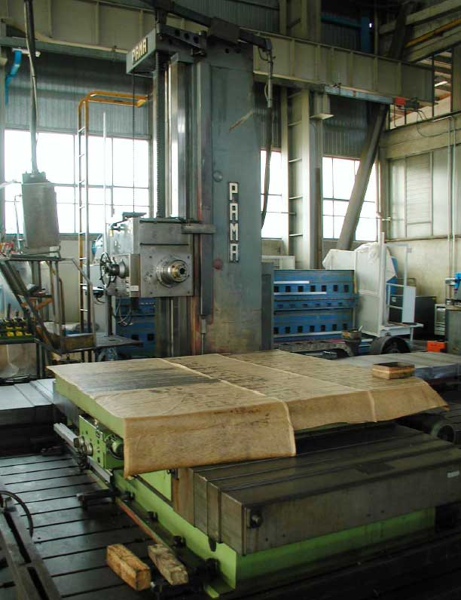
Boring & Milling Machine Rotary Table and Tools Change
ACC 127
Technical Description:
Column longitudinal travel (X axis) | 5.000mm
Headstock vertical travel (Y axis) | 2.500mm
Axial travel of spindle ram (Z axis) | 1.000mm
Boring spindle axial travel (W axis) | 300mm
Dimensions of boring spindle | 127mm
Tool type | ISO 50
Spindel speed | 3.000 RPM
Spindel power | 37 KW
Tool magazine | 60 tools
Control System | Sinumerik 840D
Dimension of rotary table | 2.500x2.000
Accuracy in Positioning and Repetition | Highest level
Maximum workpiece weight | 25T

Slide 3
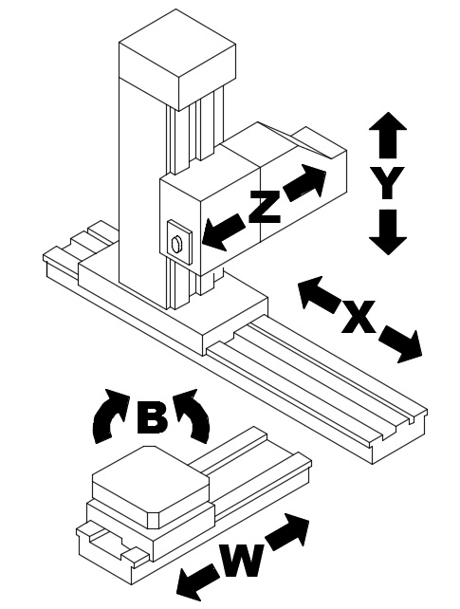
Boring & Milling Machine Rotary Table and Tools Change
ACC127

